Slide 1
Customer retention
By Ravi Prasad Bathing

Slide 2
Problem Statement
Customer satisfaction has emerged as one of the most important factors that guarantee the success of online store;
the main problem of the study is: Are customers satisfied by the services provided by the cell phone service providers
A comprehensive review of the literature, theories and models have been carried out to propose the models for customer activation and customer retention.

Slide 3
EDA Steps
1.Checking the missing values
2.Checking for numerical columns
3.Checking for the distribution of numerical variables
4.Checking for Categorical variables

Slide 4
1.Checking the missing value
Missing value can be checked by the following python code
missing value=[feature for feature in df.columns if df[feature].isnull().sum()>1]
missing_value
Observation:- There are no missing values present in the dataset

Slide 5
2. Checking the numerical columns
Numerical values can be checked using the following python code
numerical_feature=[feature for feature in df.columns if df[feature].dtypes!="O"]
df[numerical_feature]
Observation:-There are 1 numerical values present in the dataset

Slide 6
3.Checking the categorical variable
Categorical variable can be checked using the following python code
discrete_feature=[feature for feature in df.columns if feature not in numerical_feature]
df[discrete_feature]
Observation:- There are 70 categorical values present in dataset

Slide 7
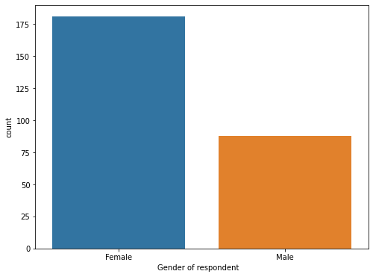
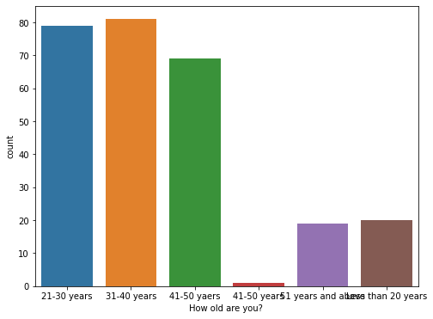
Data visualization
Gender of the respondent
How old are you?
observation:- there are 81 peoples in age between 31 and 40 years. there are 70 peoples in the age between 41 and 50 years there are 20 peoples in less than 20 years there are 19 peoples 51 years and above
observation:- There are 181 female and 88 male

Slide 8
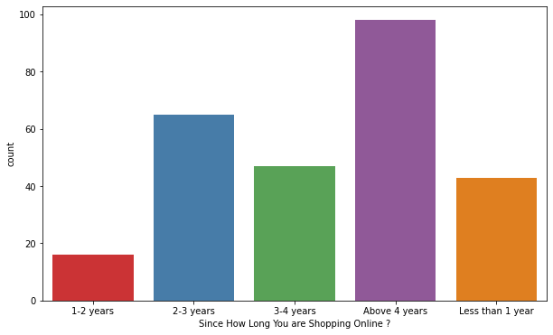
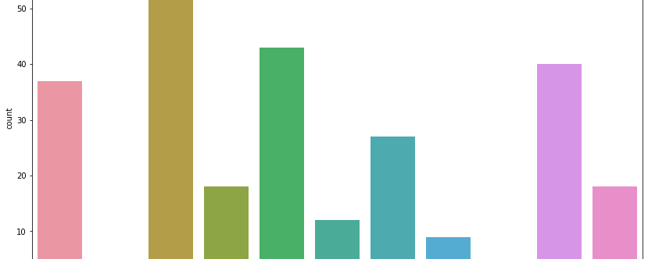
Which city do you shop online?
Since how long you are shopping online?
observation:-1. 58 people shop online from Dehli 2. 43 people shop online from Greater Noida 3.40 people shop online from Noida 4. 37 People shop online from Noida 5.27 People shop online from karnal 6.12 People shop online from Gurgaon 7.9 People shop online from Merrut 8. 5 People shop online from Moradabad 9. 2 People shop online from Bulandshahr 10. 18 people shop online from Ghaziabad
observation:-1. there are 98 people are shopping online above 4 years 2. there are 65 people are shopping online between 2 and 3 years 3. there are 47 peples are shopping online between 3 and 4 years 4. there are 43 peoples are shopping online less than 1 year 5. there are 16 peoples are shopping online in between 1 and 2 years

Slide 9
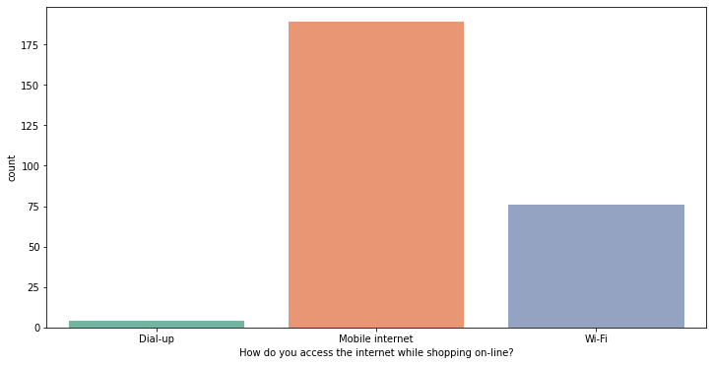
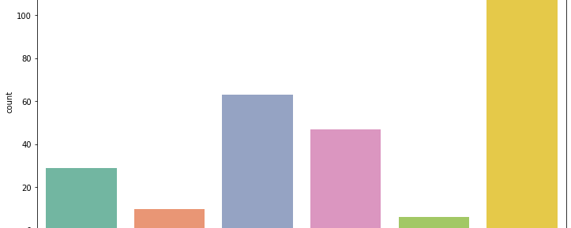
How many times you have made an online purchase in the past 1 year?
How do you access the internet while shopping on-line?
observation:- 1. There are 114 people have made online purchase less than 10 times 2. There are 63 peoples have made online purchase in between 31 and 40 times. 3. There are 47 peoples have made online purchase 41 times and above 4. There are 29 peoples have made online purchse 11-20 times 5.There are 10 peoples have made online purchase 21-30 times 6. there are 6 peoples have made online purchase 42 times and above
observation:- 1.There are 189 people accessing the mobile internet 2. There are 76 people accessing the wifi network 3. There are 4 people acccesing the Dial-up network

Slide 10
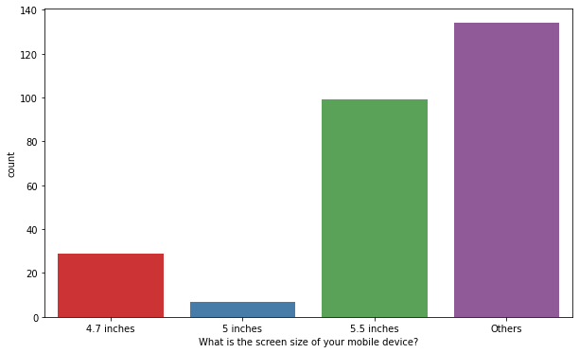
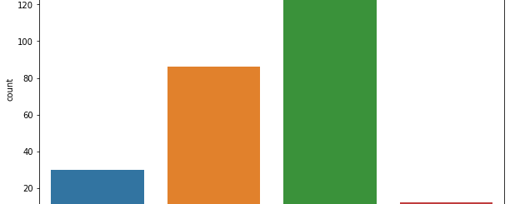
How do you access the internet while shopping on-line?
Which device do you use to access the online shopping?
observation:-
1. 141 people use smart phone to access the shopping online
2. 86 people use laptop to acess the shopping online
3. 30 people use desktop to acess the shopping online.
4. 12 people use tablet to acess the shopping online
observation:- 1.There are 189 people accessing the mobile internet
2.There are 76 people accessing the wifi network
3.There are 4 people accesing the Dial-up network

Slide 11
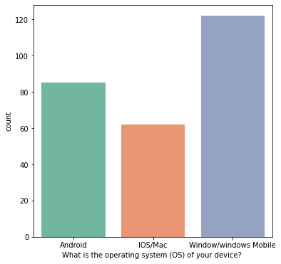
What is the screen size of your mobile device?
What is the operating system (OS) of your device?
observation:-1. The screen size of Mobile device of the people shopping online of 5.5 inches are 99
2. The screen size of Mobile device of the people shopping online of 4.7 inches are 29
3. The screen size of Mobile device of the people shopping online of 5 inches are 7
4. The screen size of Mobile device of the people shopping online of others are 134
observation:-
1. The operating system used by people who are shopping online in windows/ windows Mobile are 122.
2. The operating system used by people who are shopping online in Android are 85.
3. The operating system used by people who are shopping online in IOS/MAC are 62

Slide 12
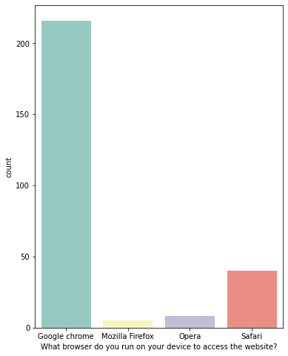
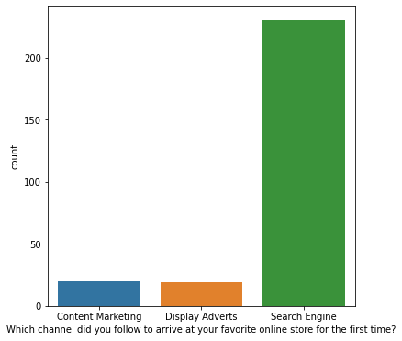
What browser do you run on your device to access the website?
Which channel did you follow to arrive at your favourite online store for the first time?
observation:- 1. the browser used by people in the device to access the website in Google Chrome are 216
2. the browser used by people in the device to access the website in safari are 40.
3. the browser used by people in the device to access the website in opera are 8
4. the browser used by people in the device to access the website in Mozilla fireFox are 5
observation:- 1.There are 230 people who follow the search engine channel to arrive at your favourite online store for the first time.
2.There are 20 people who follow the content marketing channel to arrive at your favourite online store for the first time.
3.There are 19 people who follow the Display Adverts to arrive at your favourite online store for the first time.

Slide 13
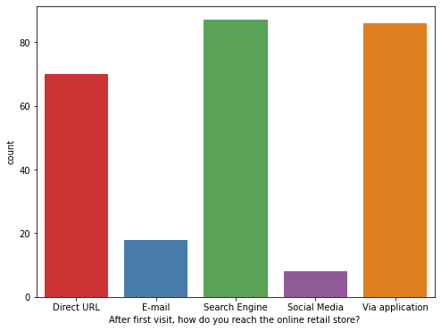
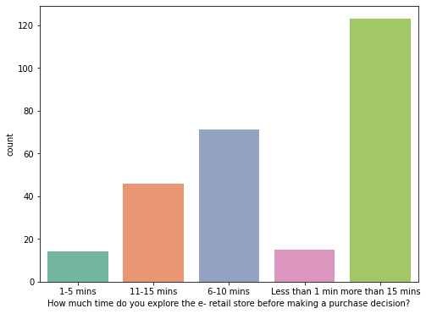
After first visit, how do you reach the online retail store
How much time do you explore the e- retail store before making a purchase decision
observation:- 1.after the first visit, people do reach the online retail score through the search engine are 87
2.after the first visit, people do reach the online retail score through the Via Application are 86
3.after the first visit, people do reach the online retail score through the Direct URL are 70.
4.after the first visit, people do reach the online retail score through the E-mail are 18.
5.after the first visit, people do reach the online retail score through the Social Media are 8
observation:- 1.the people exploring the e-retail store before making the purchase decision more than 15 mins are 123.
2.the people exploring the e-retail store before making the purchase decision between 6 and 10 minutes are 71.
3.the people exploring the e-retail store before making the purchase decision between 11 and 15 mins are 46.
4.the people exploring the e-retail store before making the purchase decision less than 1 mins are 15.
5.the people exploring the e-retail store before making the purchase decision between 1and 5 mins are 14

Slide 14
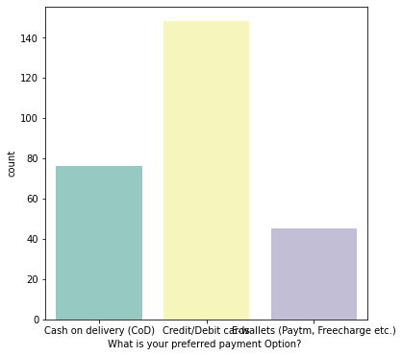
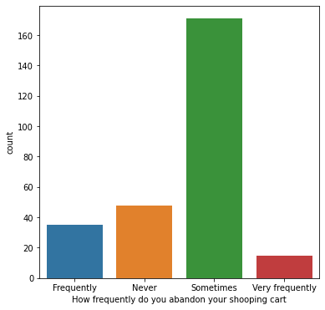
What is your preferred payment Option?
How frequently do you abandon your shopping cart
observation:-1.the people abandon on the shopping cart sometimes are 171
2.the people never abandon on the shopping cart are 48
3.the people abandon on the shopping cart frequently are 35
4.the people abandon on the shopping cart very Frequently are 15
observation:- 1. The number of people who preferred payment location as credit/debit cards are 148
2.The number of people who preferred payment location as cash on delivery are 76
3.The number of people who preferred payment location as E-wallets(paytm, Free charge etc) cards are 45

Slide 15
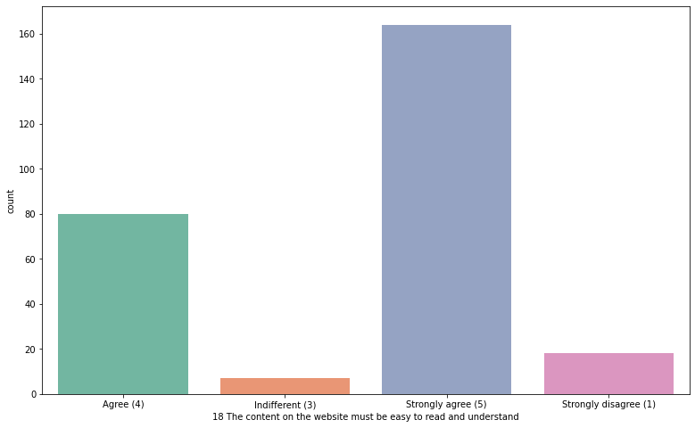
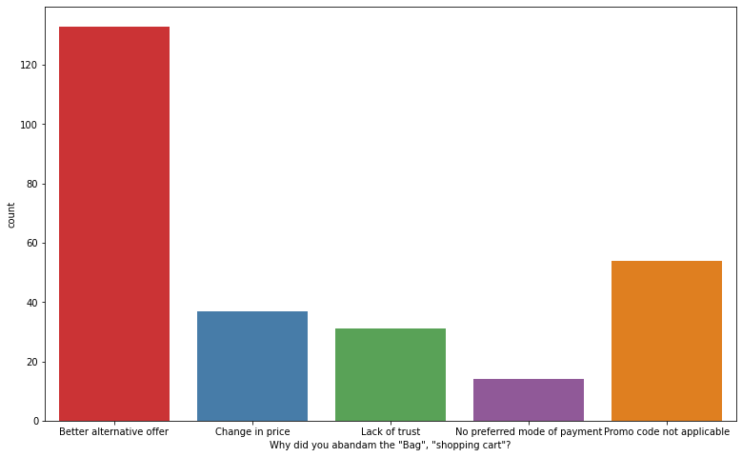
Why did you abandon the "Bag", "shopping cart
The content on the website must be easy to read and understand
observation:-
1. The people abandon the bag for better alternative offer are 133
2.The people abandon the bag for Promo code not applicable are 54
3.The people abandon the bag for change in price are 37
4. The people abandon the bag for lack of trust are 31
5. The people abandon the bag for no preferred mode of payment are 14
observation:-
1.The content must be easy to read and understand by people strongly agree are 164
2.the content must be easy to read and understand by people agree are 80
3.the content must be easy to read and understand by people stringly disagree are 18
4.the content must be easy to read and understand by people indifferent are 7

Slide 16
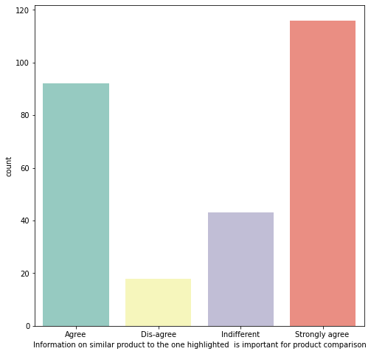
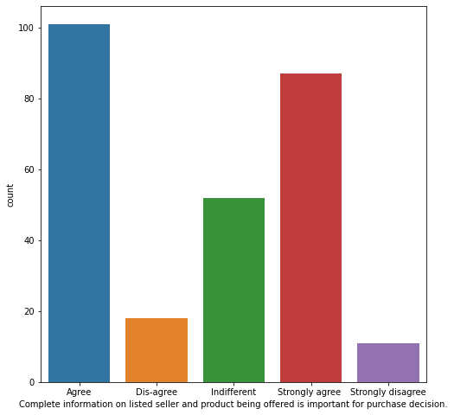
Information on similar product to the one highlighted is important for product comparison
Complete information on listed seller and product being offered is important for purchase decision
observation:-
1.information on similar product people who strongly agree are 116
2.information on similar product people who agree are 92
3.information on similar product people who are indifferent are 43
4.information on similar product people who dis-agree are 18
observation:- 1.people who agree on complete information on listed seller and product being offered is important by purchase factor are 101.
2.people who strongly agree on complete information on listed seller and product being offered is important by purchase factor are 87.
3.people who become indifferent on complete information on listed seller and product being offered is important by purchase factor are 52.
4.people who disagree on complete information on listed seller and product being offered is important by purchase factor are 18.
5.people who strongly disagree on complete information on listed seller and product being offered is important by purchase factor are 11.

Slide 17
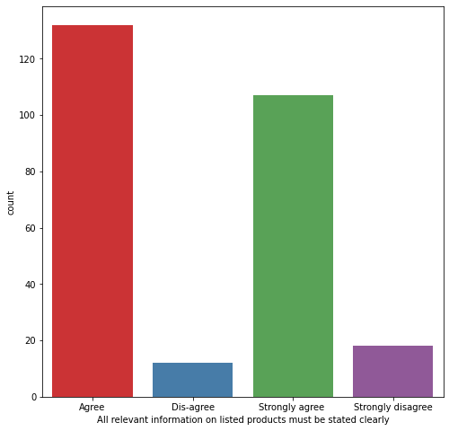
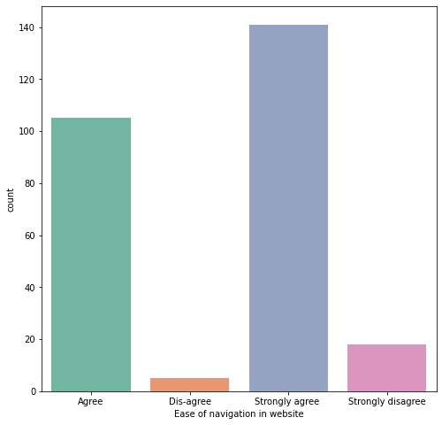
All relevant information on listed products must be stated clearly
Ease of navigation in website
observation:-1. people who agree on all relevant information on listed products are 132
2.people who strongly agree on all relevant information on listed products are 107
3.people who strongly dis-agree on all relevant information on listed products are 18
4.people who disagree on all relevant information on listed products are 12
observation:-1.people who strongly agree on ease of navigation are 141.
2.people who agree on ease of navigation ar 105
3.people who strongly disagree on ease of navigation are 18
4.people who disagree on ease of navigation are 5

Slide 18
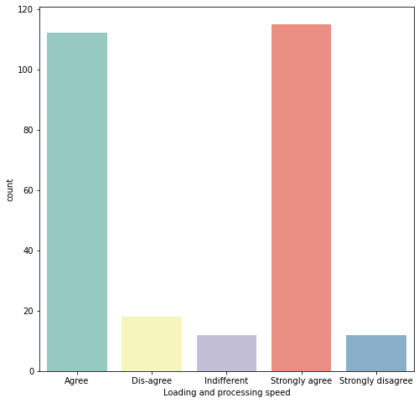
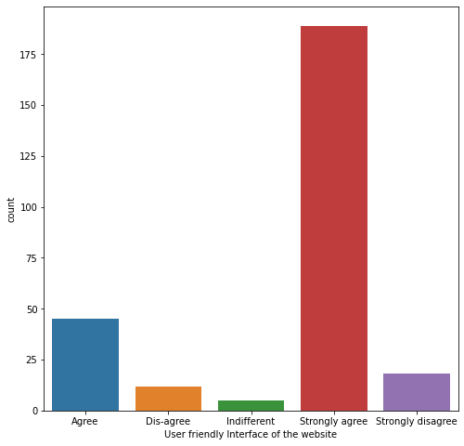
Loading and processing speed
User friendly Interface of the website
observation :- 1.people who strongly agree on loading and processing speed are 115.
2.people who agree on loading and processing the speed are 112.
3.people who dis-agree on loading and processing the speed are 18.
4.people who are indifferent in loading and processing the speed are 12.
5.people who are strongly dis-agree on loading and processing the speed are 12
observation:-1. people who strongly agree on user-friendly interface of the website are 45.
2. people who strongly disagree on user-friendly interface of website are 18.
3.people who dis-agree on user-friendly interface of website are 12
4. people who are indifferent on user friendly interface on website are 5

Slide 19
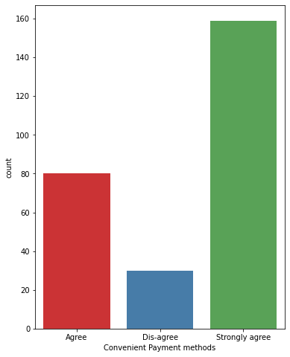
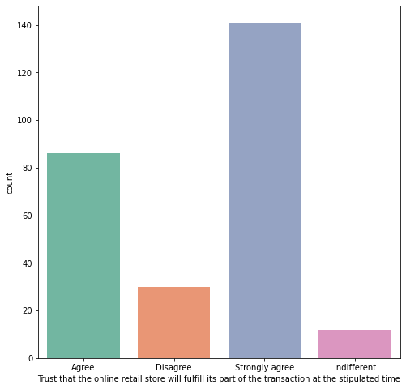
Convenient Payment methods
Trust that the online retail store will fulfill its part of the transaction at the stipulated time
observation:-1.people who strongly agree on the trust that online retail score will fulfill its part of transaction at the stipulated time are 141
2.people who agree on the trust that online retail score will fulfill its part of transaction at the stipulated time are 86
3.people who disagree on the trust that online retail score will fulfill its part of transaction at the stipulated time are 30.
4.people who are indifferent on the trust that online retail score will fulfill its part of transaction at the stipulated time are 12
observation:-1.people who strongly agree on convenient payment methods are 159.
2.people who agree on convenient payment methods are 80.
3.people who dies-agree on convenient payment methods are 30

Slide 20
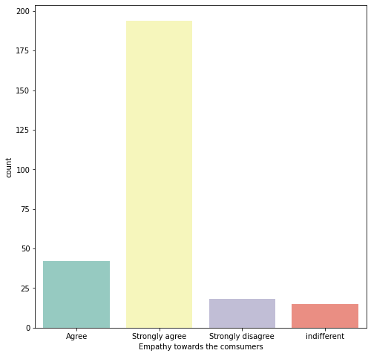
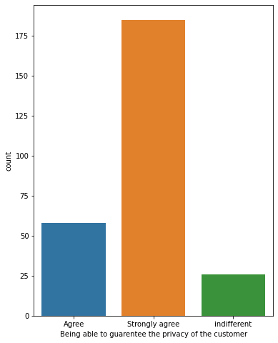
Empathy towards the consumers
Being able to guarentee the privacy of the customer
observation:-1. people who strongly agree on empathy towards the consumer are 194.
2.people who agree on empathy towards the consumer are 42
3.people who strongly disagree on empathy towards the consumer are 18.
4.people who are indifferent on empathy towards the consumer are 15.
observation:-1.people who are strongly agree on being able to guarantee the privacy of the customer are 185.
2.people who agree on being able to guarantee the privacy of the customer are 58.
3.people who are indifferent on being able to guarantee the privacy of the customer are 26

Slide 21
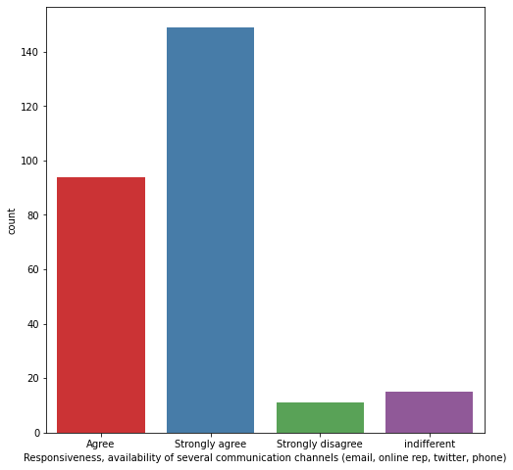
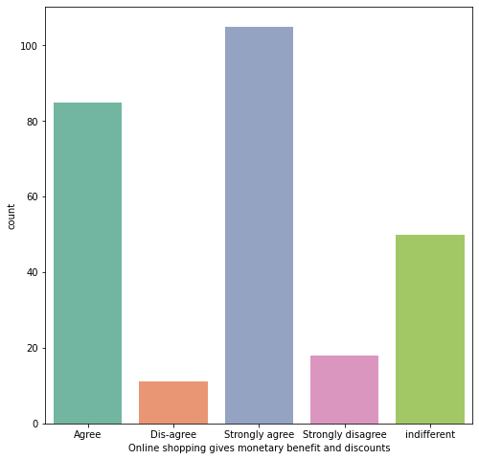
responsiveness, availability of several communication channels
Online shopping gives monetary benefit and discounts
observation:-1.people who are strongly agree on the responsiveness, availability of several communication channels are 149.
2.people who are agree on the responsiveness, availability of several communication channels are 94.
3.people who are indifferent on the responsiveness, availability of several communication channels are 15.
4.people who are strongly disagree on the responsiveness, availability of several communication channels are 11
observation:-1. people who are strongly agree on the online shopping gives monetary benefit are 105
2. people who are agree on the online shopping gives monetary benefit are 85.
3.people who are indifferent on the online shopping gives monetary benefit are 50.
4.people who are strongly disagree on the online shopping gives monetary benefit are 18.
5.people who are dis-agree on the online shopping gives monetary benefit are 11

Slide 22
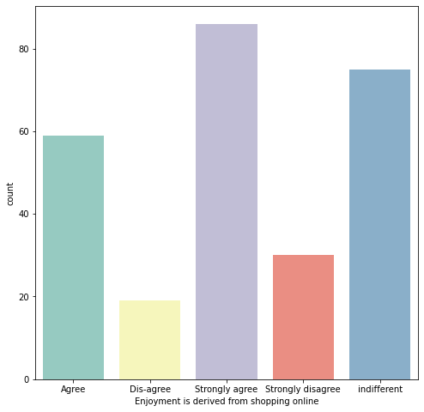
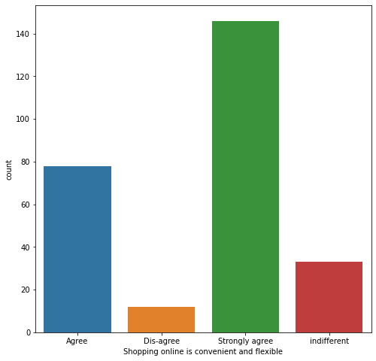
Enjoyment is derived from shopping online
Shopping online is convenient and flexible
observation:-1. people who are strongly agree on the enjoyment is derived from shopping online are 86.
2.people who are indifferent on the enjoyment is derived from shopping online are 75.
3.people who are agree on the enjoyment is derived from shopping online are 59.
4.people who are strongly disagree on enjoyment is derived from shopping online are 30.
5.people who are disagree on the enjoyment is derived from shopping online are 19.
observation:-1.People who are strongly agree on the shopping online is convenient and flexible are 146
2.People who are agree on the shopping online is convenient and flexible are 78.
3.people who are indifferent on the shopping online is convenient and flexible are 33
4.people who are disagree on the shopping online are 12

Slide 23
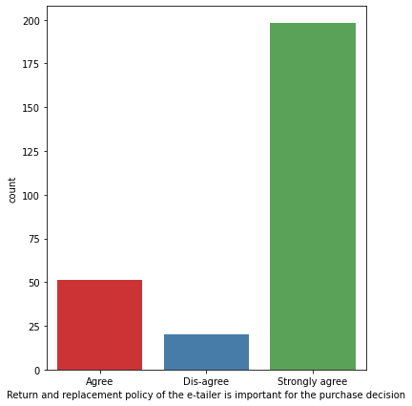
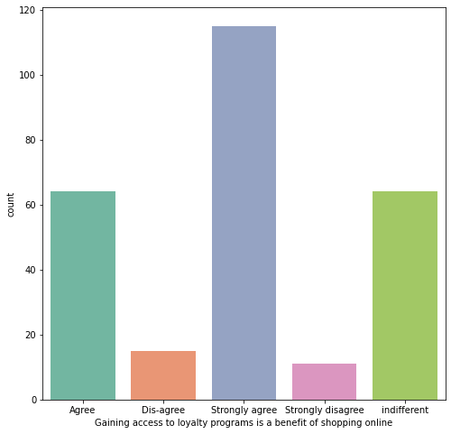
Return and replacement policy of the e-tailer is important for the purchase decision
Gaining access to loyalty programs is a benefit of shopping online
observation:-1. people who are strongly agree on the gaining access to loyalty programs is a benefit of shopping online are 115
2.people who are indifferent on the gaining access to loyalty programs is a benefit of shopping online are 64.
3.people who are agree on the gaining access to loyalty programs is a benefit of shopping online are 64
4.people who are disagree on the gaining access to loyalty programs is a benefit of shopping online are 15
5.people who are strongly disagree on the gaining access to loyalty programs is a benefit of shopping online are 11
observation:-1.people who strongly agree on return and replacement policy of the e-tailor is important for the purchase decision are 198.
2.people who agree on return and replacement policy of the e-tailor is important for the purchase decision are 51.
3.people who dis-agree on return and replacement policy of the e-tailor is important for the purchase decision are 20

Slide 24
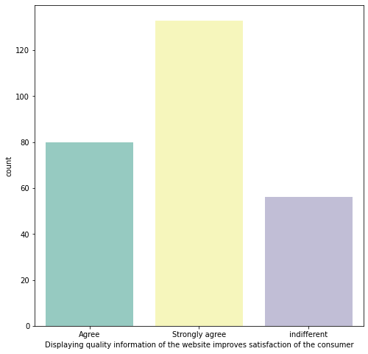
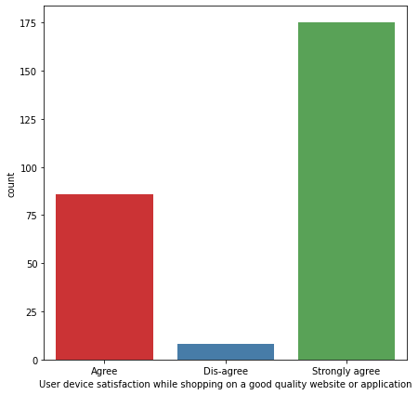
Displaying quality information of the website improves satisfaction of the consumer
User device satisfaction while shopping on a good quality website or application
observation:-1.people who are strongly agree on displaying the quality information of the website improves satisfaction of the customer are 133.
2.people who are agree on displaying the quality information of the website improves satisfaction of the customer are 80.
3.people who are indifferent on displaying the quality information of the website improves satisfaction of the customer are 56
observation:-1. people who are strongly agree on User device satisfaction while shopping on a good quality website or application are 175.
2.people who are agree on User device satisfaction while shopping on a good quality website or application are 86.
3.people who are disagree on User device satisfaction while shopping on a good quality website or application are 8.

Slide 25
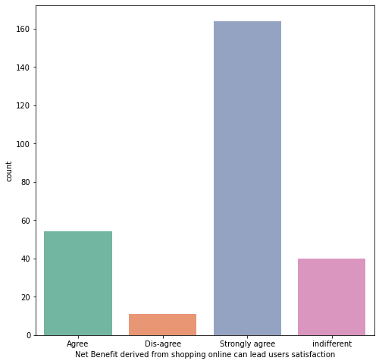
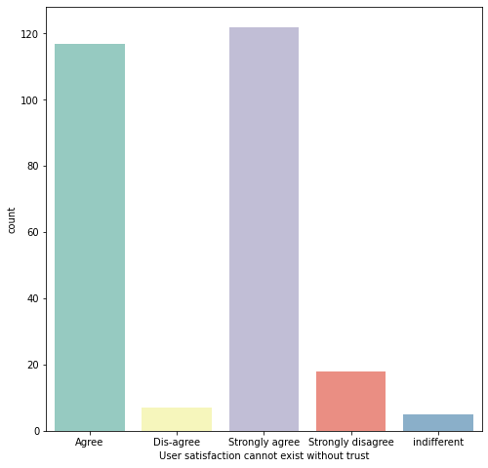
Net Benefit derived from shopping online can lead users satisfaction
User satisfaction cannot exist without trust
observation:-1.people who are strongly agree on Net Benefit derived from shopping online can lead users satisfaction are 164.
2.people who are agree on Net Benefit derived from shopping online can lead users satisfaction are 54
3.people who are indifferent on Net Benefit derived from shopping online can lead users satisfaction are 40.
4.people who are disagree on Net Benefit derived from shopping online can lead users satisfaction are 11.
observation:-1.people who are strongly agree on the user satisfaction cannot exist without trust are 122.
2.people who are agree on the user satisfaction cannot exist without trust are 122.
3.people who are strongly disagree on the user satisfaction cannot exist without trust are 122.
4.people who are disagree on the user satisfaction cannot exist without trust are 122.
5.people who are indifferent on the user satisfaction cannot exist without trust are 122.

Slide 26
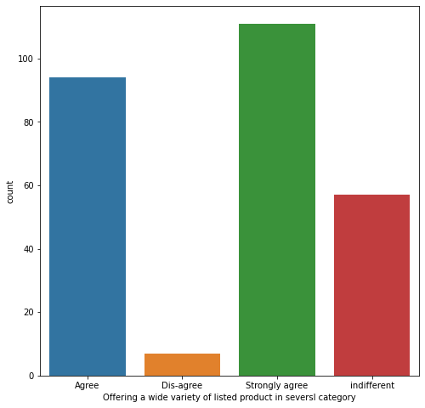
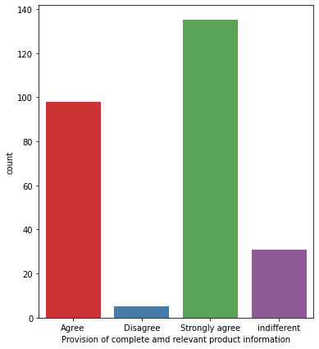
Offering a wide variety of listed product in several category
Provision of complete and relevant product information
observation:-1.people who strongly agree on Offering a wide variety of listed product in several category are 111
2.people who agree on Offering a wide variety of listed product in several category are 94.
3. people who are indifferent on Offering a wide variety of listed product in several category are 57
4.people who are disagree on Offering a wide variety of listed product in several category are 7
observation:-1.people who strongly agree on the Provision of complete and relevant product information are 135
2.people who agree on the Provision of complete and relevant product information are 98
3.people who are in different on the Provision of complete and relevant product information are 31
4.people who are disagree on the Provision of complete and relevant product information are 5

Slide 27
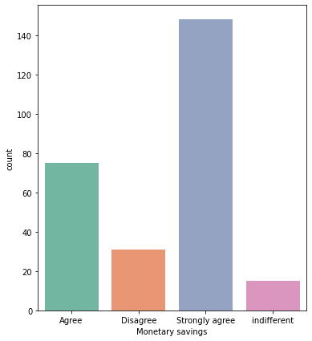
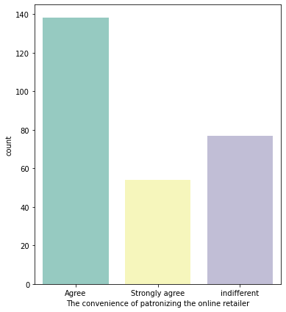
Monetary savings
The convenience of patronizing the online retailer
observation:-1.people who are strongly agree on the monetary savings are 148
2.people who are agree on the monetary savings are 75
3.people who are disagree on the monetary savings are 31
4.people who are indifferent on the monetary savings are 15
observation:-1.people who are strongly agree on The convenience of patronizing the online retailer are 138
2.people who are indifferent on The convenience of patronizing the online retailer are 77
3.people who are strongly agree on The convenience of patronizing the online retailer are 54

Slide 28
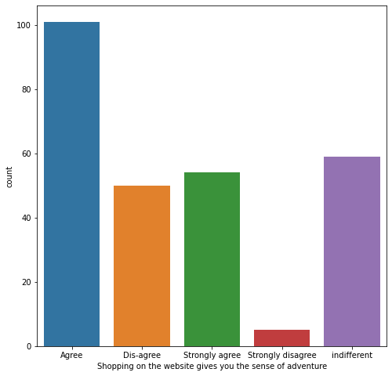
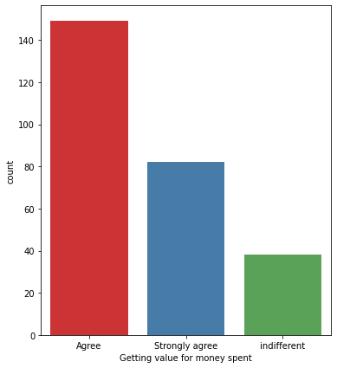
Shopping on the website gives you the sense of adventure
Getting value for money spent
observation:-1.people who agree on Shopping on the website gives you the sense of adventure are 101
2.people who are indifferent on Shopping on the website gives you the sense of adventure are 59
3.people who strongly-agree on Shopping on the website gives you the sense of adventure are 54
4.people who dis-agree on Shopping on the website gives you the sense of adventure are 50.
5. people who strongly disagree on Shopping on the website gives you the sense of adventure are 5
observation:-1.people who are agree on Getting value for money spent are 149
2.people who are strongly agree on Getting value for money spent are 82
3.people who are indifferent on Getting value for money spent are 38

Slide 29
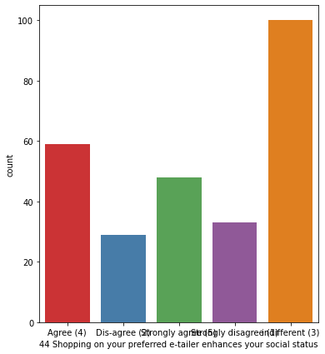
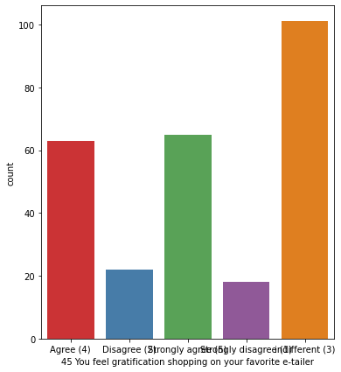
Shopping on the preferred e tailer enhances your social status
You feel gratification shopping on your favorite e-tailer
observation:-1.people who agree on Shopping on the preferred e-tailer enhances thier social status are 59 2.people who are indifferent on Shopping on your preferred e-tailer enhances your social status are 100 3.people who strongly-agree on Shopping Shopping on your preferred e-tailer enhances your social status 48 4.people who dis-agree on Shopping on your preferred e-tailer enhances your social status the sense of adventure are 29. 5. people who strongly disagree on Shopping on your preferred e-tailer enhances your social status are 33
observation:-1.people who agree on feel gratification shopping on your favorite e-tailer are 63 2.people who are indifferent on feel gratification shopping on your favorite e-tailer are 101 3.people who strongly-agree on feel gratification shopping on your favorite e-tailer 65 4.people who dis-agree on feel gratification shopping on your favorite e-tailer are 22. 5. people who strongly disagree on feel gratification shopping on your favorite e-tailer are 18

Slide 30
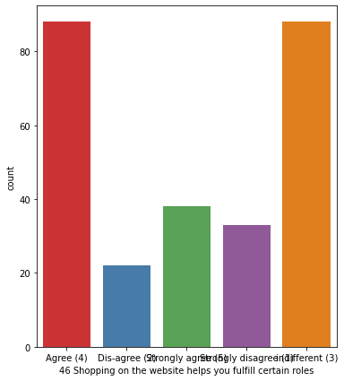
observation:-1.people who agree on Shopping on the website helps you fulfill certain roles are 88 2.people who are indifferent Shopping on the website helps you fulfill certain rolesare 88 3.people who strongly-agree on Shopping on the website helps you fulfill certain roles 38 4.people who dis-agree on Shopping on the website helps you fulfill certain roles are 22. 5. people who strongly disagree on Shopping on the website helps you fulfill certain roles are 33
Shopping on the website helps you fulfill certain roles

Slide 31
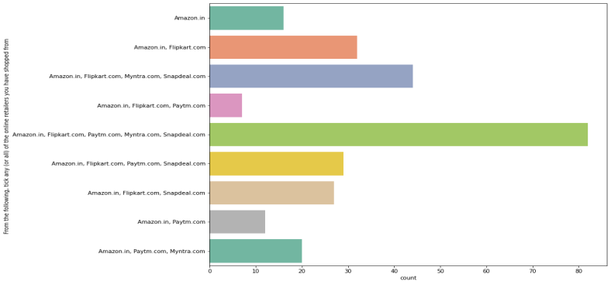
From the following, tick any (or all) of the online retailers you have shopped from?
observation:-
1.From the following, the online retailers people have shopped from Amazon.in, Flipkart.com, Paytm.com, Myntra.com, Snapdeal.com
are 82
2.From the following, the online retailers people have shopped from Amazon.in, Flipkart.com, Myntra.com, Snapdeal.com
are 44
3.From the following, the online retailers people have shopped from Amazon.in, Flipkart.com, are 32
4.From the following, the online retailers people have shopped from Amazon.in, Flipkart.com, Paytm.com, Snapdeal.com are 29
5.From the following, the online retailers people have shopped from Amazon.in, Flipkart.com, Snapdeal.com are 27
6.From the following, the online retailers people have shopped from Amazon.in, Flipkart.com, Paytm.com, Snapdeal.com
are 20.
7.From the following, the online retailers people have shopped from Amazon.in are 16.
8.From the following, the online retailers people have shopped from Amazon.in, Flipkart.com, Paytm.com are 12.
9.From the following, the online retailers people have shopped from Amazon.in, Flipkart.com, Paytm.com are 7

Slide 32
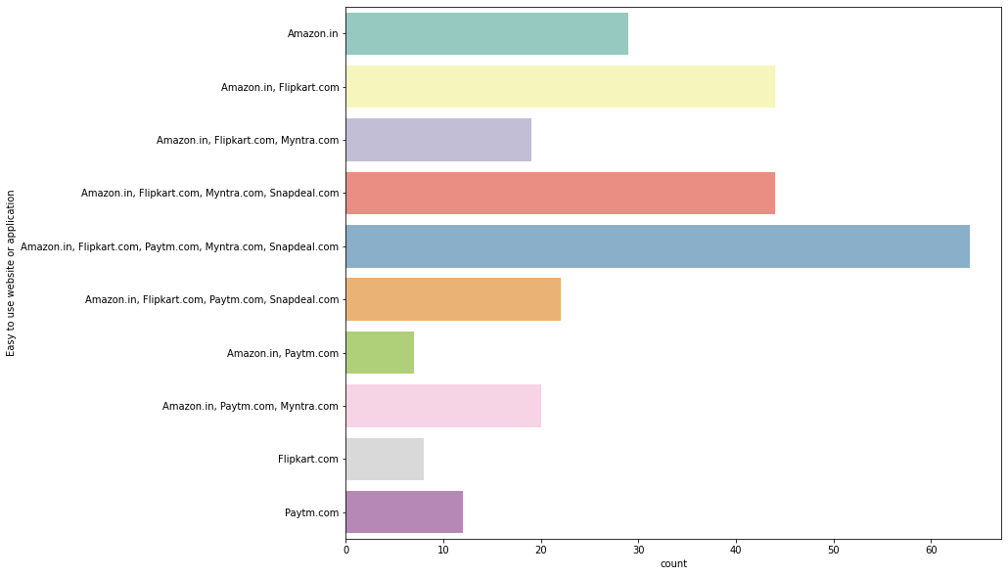
Easy to use website or application
observation:-1.people Easy to use website or application in Amazon.in, Flipkart.com, Paytm.com, Myntra.com, Snapdeal.com are 64
2.people Easy to use website or application in Amazon.in, Flipkart.com are 44
3.people Easy to use website or application in Amazon.in, Flipkart.com, Myntra.com, Snapdeal.com are 44.
4.people Easy to use website or application in Amazon.in are 29.
5.people Easy to use website or application in Amazon.in, Flipkart.com, Paytm.com, Snapdeal.com are 22.
6.people Easy to use website or application in Amazon.in, Paytm.com, Myntra.com are 20
7.people Easy to use website or application in Amazon.in, Flipkart.com, Myntra.com are 19.
8.people Easy to use website or application in paytm.com are 12
9.people Easy to use website or application in Flipkart.com are 8
10.people Easy to use website or application in Amazon.in, paytm.com are 7

Slide 33
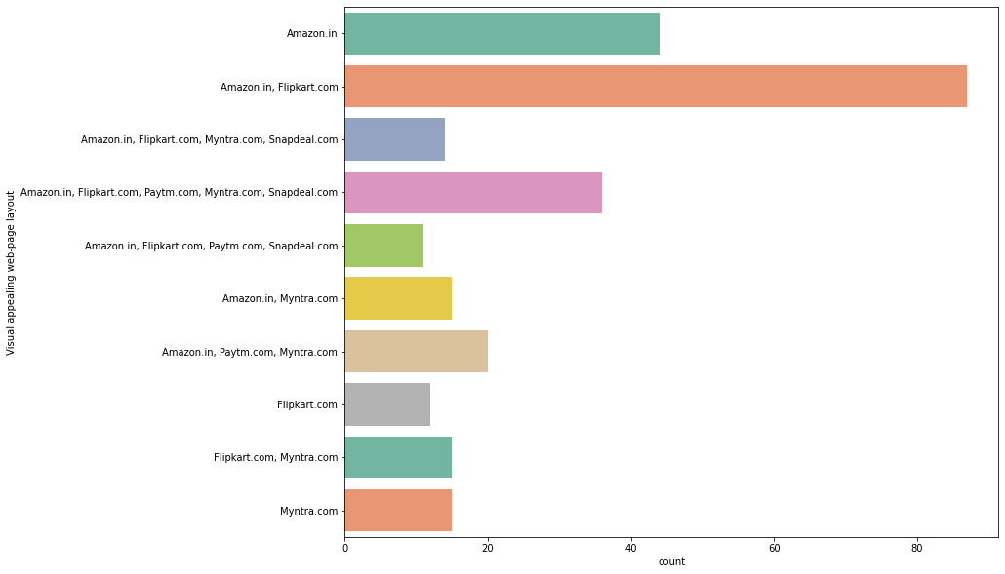
Visual appealing web-page layout
observation:-1.people who visual appealing the web page layout in Amazon.in, Flipkart.com are 87
2.people who visual appealing the web page layout in Amazon.in, Flipkart.com, paytm.com, myntra.com, snapdeal.com are 44.
3.people who visual appealing the web page layout in Amazon.in, Flipkart.com, Paytm.com, Myntra.com, Snapdeal.com are 36
4.people who visual appealing the web page layout in Amazon.in, Paytm.com, Myntra.com are 20
5.people who visual appealing the web page layout in Amazon.in, Myntra.com are 15
6.people who visual appealing the web page layout in Myntra.com are 15.
7.people who visual appealing the web page layout in Flipkart.com, Myntra.com are 15
8.people who visual appealing the web page layout in Amazon.in, Flipkart.com, Myntra.com, Snapdeal.com are 14
9.people who visual appealing the web page layout in Flipkart.com are 12
10.people who visual appealing the web page layout in Amazon.in, Flipkart.com, paytm.com, Snapdeal.com are 11

Slide 34
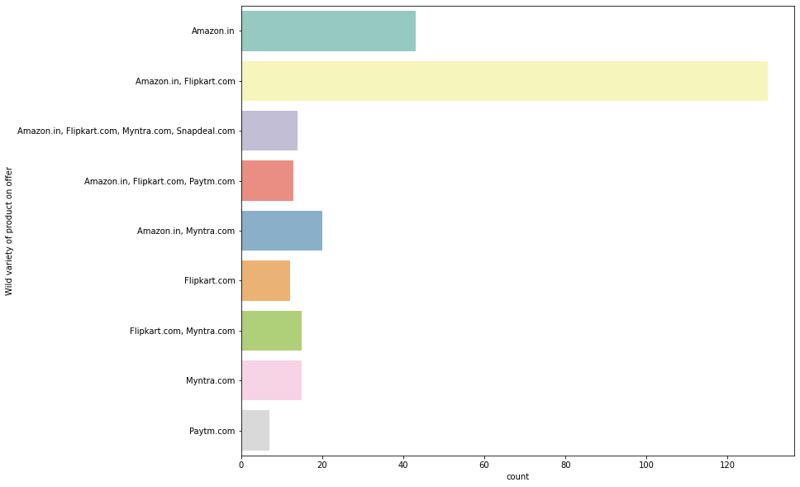
Wide variety of product on offer
observation:-1.wide variety of product on offer in Amazon.in, Flipkart.com are 130
2.wide variety of product on offer in Amazon.in are 43
3.wide variety of product on offer in Amazon.in, myntra.com are 20
4.wide variety of product on offer in Myntra.com, Flipkart.com are 15
5.wide variety of product on offer in Myntra.com are 15
6.wide variety of product on offer in Amazon.in, Flipkart.com, Myntra.com, Snapdeal.com are 14
7.wide variety of product on offer in Amazon.in, Flipkart.com, Paytm.com are 13
8.wide variety of product on offer in flipkart.com are 12
9.wide variety of product on offer in paytm.com are 7

Slide 35

Complete, relevant description information of products
observation:1.-people know the Complete, relevant description information of products on Amazon.in, Flipkart.com are 100
2.people know the Complete, relevant description information of products on Amazon.in are 43
3.people know the Complete, relevant description information of products on Amazon.in, Flipkart.com, paytm.com are 24
4.people know the Complete, relevant description information of products on Amazon.in, Paytm.com, Myntra.com are 20
5.people know the Complete, relevant description information of products on Amazon.in, Flipkart.com, Paytm.com, Myntra.com, Snapdeal.com are 15
6.people know the Complete, relevant description information of products on Amazon.in, Flipkart.com, Myntra.com are 15.
7.people know the Complete, relevant description information of products on Amazon.in, Flipkart.com, Paytm.com, Myntra.com, Snapdeal.com are 14.
8.people know the Complete, relevant description information of products on Snapdeal.com are 12.
9.people know the Complete, relevant description information of products on Flipkart.com, Snapdeal.com are 11.
10.people know the Complete, relevant description information of products on Flipkart.com are 8
11.people know the Complete, relevant description information of products on Amazon.com, Flipkart.com, Snapdeal.com are 7

Slide 36

Fast loading website speed of website and application
observation:-
1.fast loading website speed of website and application in Amazon.in are 51
2.fast loading website speed of website and application in Amazon.in, Paytm.com are 44
3.fast loading website speed of website and application in Amazon.in, Flipkart.com, Myntra.com, Snapdeal.com are 30
4.fast loading website speed of website and application in Amazon.in, Flipkart.com, Snapdeal.com are 25
5.fast loading website speed of website and application in Amazon.in, Flipkart.com, Paytm.com are 25
6.fast loading website speed of website and application in Amazon.in, Flipkart.com, Paytm.com.com, Myntra.com are 14
7.fast loading website speed of website and application in snapdeal.com are 12.
8.fast loading website speed of website and application in Flipkart.com are 8

Slide 37

Reliability of the website or application
observation:-1.Reliability of the website or application on Amazon.in are 61
2.Reliability of the website or application on Amazon.in, flipkart.com are 50
3.Reliability of the website or application on Amazon.in, Flipkart.com, Paytm.com are 36
4.Reliability of the website or application on Amazon.in, Paytm.com, Myntra.com are 35
5.Reliability of the website or application on Amazon.in, Flipkart.com, Snapdeal.com are 18
6.Reliability of the website or application on Flipkart.com are 15
7.Reliability of the website or application on Myntra.com are 15
8.Reliability of the website or application on Amazon.in, Flipkart.com, Myntra.com, Snapdeal.com are 14
9.Reliability of the website or application on Amazon.in, Flipkart.com, Paytm.com, Snapdeal.com are 13
10.Reliability of the website or application on Paytm.com are 12

Slide 38
Quickness to complete purchase
observation:-1.Quickness to complete purchase on Amazon.in are 66
2.Quickness to complete purchase on Amazon.com, Flipkart.com, Paytm.com are 37
3.Quickness to complete purchase on Amazon.com, Flipkart.com are 30.
4.Quickness to complete purchase on Amazon.com, Flipkart.com, Paytm.com are 20
5.Quickness to complete purchase on Amazon.com, Flipkart.com, Myntra.com are 30.
6.Quickness to complete purchase on Paytm.com are 25.
7.Quickness to complete purchase on Amazon.com, Flipkart.com, Myntra.com are 30
8.Quickness to complete purchase on Amazon.com, Flipkart.com, Myntra.com are 30

Slide 39

Availability of several payment options
observation:-
1.Availability of several payment options on Amazon.in, Flipkart.com by people is 65
2.Availability of several payment options on Amazon.in, Flipkart.com, Myntra.com by people is 40.
3.Availability of several payment options on Amazon.in, Flipkart.com, Patym.com, Myntra.com, Snapdeal.com by people is 39.
4.Availability of several payment options on Amazon.in by people is 23
5.Availability of several payment options on Patym.com, Myntra.com by people is 20.
6.Availability of several payment options on Amazon.in, Flipkart.com, Myntra.com, Snapdeal.com by people is 19
7.Availability of several payment options on Amazon.in, Flipkart.com, Snapdeal.com by people is 18.
8.Availability of several payment options on Flipkart.com, Myntra.com, Snapdeal.com by people is 14.
9.Availability of several payment options on paytm.com by people is 12.
10.Availability of several payment options on Amazon.in, Patym.com by people is 11.
11.Availability of several payment options on Flipkart.com by people is 8.

Slide 40

Speedy order delivery
observation:- 1.speedy order delivery on Amazon.in are 107.
2.speedy order delivery on Amazon.in, Flipkart.com are 82.
3.speedy order delivery on Amazon.in, Flipkart.com, Snapdeal.com are 36.
4.speedy order delivery on Flipkart.com are 36.
5.speedy order delivery on Amazon.in, Flipkart.com, Myntra.com are 15.
6.speedy order delivery on Flipkart.com, Myntra.com, Snapdeal.com are 14.

Slide 41

Privacy of customers information
observation:- privacy of customers information by people in Amazon.in are 71
privacy of customers information by people in Amazon.in, Flipkart.com are 54
privacy of customers information by people in Amazon.in, Flipkart.com, Myntra.com are 25
privacy of customers information by people in Amazon.in, Flipkart.com, Paytm.com, Myntra.com, Snapdeal.com are 24
privacy of customers information by people in Paytm.com are 18
privacy of customers information by people in Flipkart.com are 15
privacy of customers information by people in Myntra.com are 15
privacy of customers information by people in Amazon.in, Paytm.com are 15.
privacy of customers information by people in Amazon.in, Flipkart.com, Myntra.com, Snapdeal.com are 14
privacy of customers information by people in Amazon.in, Flipkart.com, Paytm.com are 11
privacy of customers information by people in Amazon.in, Flipkart.com, Snapdeal.com are 7

Slide 42

Security of customer financial information
observation:-
Security of customer financial information on Amazon.in is 51
Security of customer financial information on Amazon.in, Flipkart.com, Paytm.com, Myntra.com, Snapdeal.com is 33
Security of customer financial information on Flipkart.com is 33
Security of customer financial information on Amazon.in, Flipkart.com, Snapdeal.com is 25
Security of customer financial information on Amazon.in, Flipkart.com is 24
Security of customer financial information on Amazon.in, Paytm.com, Myntra.com is 20
Security of customer financial information on Amazon.in, Snapdeal.com is 19
Security of customer financial information on Myntra.com is 15
Security of customer financial information on paytm.com is 15.
Security of customer financial information on Amazon.in, Flipkart.com, Myntra.com, Snapdeal.com is 14.
Security of customer financial information on Amazon.in, Flipkart.com, paytm.com is 11.

Slide 43

Perceived Trustworthiness
observation:-1. perceived trustworthiness on Amazon.in are 76
2.perceived trustworthiness on Amazon.in, Flipkart.com, Snapdeal.com are 36
3.perceived trustworthiness on Amazon.in, Myntra.com are 35
4.perceived trustworthiness on Amazon.in, flipkart.com are 31
5.perceived trustworthiness on flipkart.com are 27
6.perceived trustworthiness on Amazon.in, Flipkart.com, Myntra.com, Snapdeal.com are 25
7.perceived trustworthiness on Amazon.in, Flipkart.com, Paytm.com, Myntra.com, Snapdeal.com are 13
8.perceived trustworthiness on Amazon.in, Flipkart.com, Paytm.com are 11

Slide 44

Presence of online assistance through multi-channel
observation:-Presence of online assistance through multi-channel on Amazon.in, Flipkart.com, Myntra.com, Snapdeal are 61
Presence of online assistance through multi-channel on Amazon.in is 60
Presence of online assistance through multi-channel on Amazon.in, Flipkart.com is 39
Presence of online assistance through multi-channel on Amazon.in, Snapdeal.com is 26
Presence of online assistance through multi-channel on Myntra.com is 20
Presence of online assistance through multi-channel on Amazon.in, Flipkart.com, Myntra.com is 15
presence of online assistance through multi-channel on Amazon.in, Myntra.com is 15
presence of online assistance through multi-channel on Amazon.in, Flipkart.com, Paytm.com is 13
presence of online assistance through multi-channel on Flipkart.com is 8

Slide 45

Longer time to get logged in (promotion, sales period)
observation:-1.Longer time to get logged in Amazon.in are 57
2.Longer time to get logged in paytm.com are 38
3.Longer time to get logged in Amazon.in, Flipkart.com are 38
4. Longer time to get logged in Myntra.com are 35
5.Longer time to get logged in Amazon.in, Flipkart.com, Snapdeal.com are 29
6.Longer time to get logged in Flipkart.com, Paytm.com are 15
7.Longer time to get logged in Flipkart.com, Paytm.com, Snapdeal.com are 13
8.Longer time to get logged in Amazon.in, Paytm.com are 11
9.Longer time to get logged in Flipkart.com are 8

Slide 46

Longer time in displaying graphics and photos (promotion, sales period)
observation:-
1.Longer time in displaying graphics and photos on Amazon.in, Flipkart.com are 60
2.Longer time in displaying graphics and photos on Amazon.in are 39
3.Longer time in displaying graphics and photos on Myntra.com are 35
4.Longer time in displaying graphics and photos on snapdeal.com are 34
5.Longer time in displaying graphics and photos on Myntra.com snapdeal.com are 25
6.Longer time in displaying graphics and photos on Flipkart.com snapdeal.com are 19
7.Longer time in displaying graphics and photos on paytm.com are 15
8.Longer time in displaying graphics and photos on Amazon.in, Myntra.com, Snapdeal.com are 14
9.Longer time in displaying graphics and photos on Amazon.in, paytm.com are 13

Slide 47

Late declaration of price (promotion, sales period)
observation:-Late declaration of price (promotion, sales period) on Myntra.com are 75
Late declaration of price (promotion, sales period) on paytm.com are 41
Late declaration of price (promotion, sales period) on paytm.com are 52
Late declaration of price (promotion, sales period) on snapdeal.com are 41
Late declaration of price (promotion, sales period) on flipkart.com are 38
Late declaration of price (promotion, sales period) on Amazon.in are 38
Late declaration of price (promotion, sales period) on Amazon.in, Paytm.com are 13.
Late declaration of price (promotion, sales period) on Paytm.com, snapdeal.com are 7.
Late declaration of price (promotion, sales period) on Amazon.in, Flipkart.com are 5.

Slide 48

Longer page loading time (promotion, sales period
observation:-Longer page loading time (promotion, sales period) on Myntra.com are 61
Longer page loading time (promotion, sales period) on paytm.com are 59
Longer page loading time (promotion, sales period) on FlipKart.com are 32
Longer page loading time (promotion, sales period) on snapdeal.com are 23
Longer page loading time (promotion, sales period) on Amazon.in, Flipkart.com are 18
Longer page loading time (promotion, sales period) on Amazon.in are 16
Longer page loading time (promotion, sales period) on Paytm.com, Snapdeal.com are 15
Longer page loading time (promotion, sales period) on Amazon.in, Snapdeal.com are 14
Longer page loading time (promotion, sales period) on Amazon.in, Paytm.com are 13
Longer page loading time (promotion, sales period) on Flipkart.com, Snapdeal.com are 11
Longer page loading time (promotion, sales period) on Amazon.in, Paytm.com, Myntra.com are 7

Slide 49

Limited mode of payment on most products (promotion, sales period)
observation:-Limited mode of payment on most products (promotion, sales period) on Snapdeal.com are 87
Limited mode of payment on most products (promotion, sales period) on Amazon.in are 62
Limited mode of payment on most products (promotion, sales period) on Flipkart.com are 31
Limited mode of payment on most products (promotion, sales period) on Amazon.in, Flipkart.com are 29
Limited mode of payment on most products (promotion, sales period) on paytm.com are 25
Limited mode of payment on most products (promotion, sales period) on Paytm.com, Snapdeal.com are 15
Limited mode of payment on most products (promotion, sales period) on Amazon.in, Paytm.com are 13
Limited mode of payment on most products (promotion, sales period) on Myntra.com, Snapdeal.com are 7

Slide 50

Longer delivery period
observation:-1.Longer delivery period on paytm.com are 72
2. longer delivery period on snapdeal.com are 64
3.longer delivery period on Flipkart.com are 44
4.longer delivery period on Amazon.in are 37
5.longer delivery period on Paytm.com, Snapdeal.com are 26
6.longer delivery period on myntra.com are 26

Slide 51

Change in website/Application design
observation:-
1.Change in website/Application design in Amazon.com is 96
2.Change in website/Application design in Paytm.com is 63
3.Change in website/Application design in Amazon.in, Flipkart.com is 45
4.Change in website/Application design in Myntra.com is 45
5.Change in website/Application design in Flipkart.com is 20.
6.Change in website/Application design in Snapdeal.com is 8.
7.Change in website/Application design in Flipkart.com, Myntra.com is 7.

Slide 52

Frequent disruption when moving from one page to another
observation:-1. Frequent disruption when moving from one page to another in Amazon.in are 53
2. Frequent disruption when moving from one page to another in Myntra.com are 52
3. Frequent disruption when moving from one page to another in snapdeal.com are 49
4. Frequent disruption when moving from one page to another in paytm.com are 39
5.Frequent disruption when moving from one page to another in Flipkart.com are 26
6. Frequent disruption when moving from one page to another in Amazon.in, Flipkart.com are 25
7.Frequent disruption when moving from one page to another in Myntra.com, Snapdeal.com are 14
8.Frequent disruption when moving from one page to another in Flipkart.com, Snapdeal.com are 11

Slide 53

Website is as efficient as before
observation:-1.Website is as efficient as before in Amazon. in for 94 peoples
2.Website is as efficient as before in Flipkart.com for 47 peoples
3.Website is as efficient as before in Amazon. in, Flipkart.com for 45 peoples
4.Website is as efficient as before in Amazon. in, Flipkart.com, paytm.com for 25 peoples
5.Website is as efficient as before in Amazon. in, paytm.com for 18 peoples
6.Website is as efficient as before in paytm.com for 15 peoples
7.Website is as efficient as before in Amazonian, Paytm.com for 18 peoples
8.Website is as efficient as before in Paytm.com for 15 peoples
9.Website is as efficient as before in Paytm.com for 15 peoples
10. Website is as efficient as before in Myntra.com, Snapdeal.com for 14 peoples
11.Website is as efficient as before in Snapdeal.com for 11 peoples

Slide 54

Which of the Indian online retailer would you recommend to a friend
observation:-1.the Indian online retailer would you recommend to a friend by people in Amazon. in are 79
2. the Indian online retailer would you recommend to a friend by people in Amazon. in, Flipkart.com are 39
3.the Indian online retailer would you recommend to a friend by people in Amazon. in, Flipkart.com are 62
4.the Indian online retailer would you recommend to a friend by people in Flipkart.com are 39
5.the Indian online retailer would you recommend to a friend by people in Amazon. in, Myntra.com are 30
6.the Indian online retailer would you recommend to a friend by people in Amazon. in, Paytm.com, Myntra.com are 20
7.the Indian online retailer would you recommend to a friend by people in Amazon. in, Flipkart.com, Myntra.com are 15
8.the Indian online retailer would you recommend to a friend by people in Amazon. in, Paytm.com are 13
9.the Indian online retailer would you recommend to a friend by people in Flipkart.com, Paytm.com, Myntra.com, snapdeal.com are 11

